Slide 1
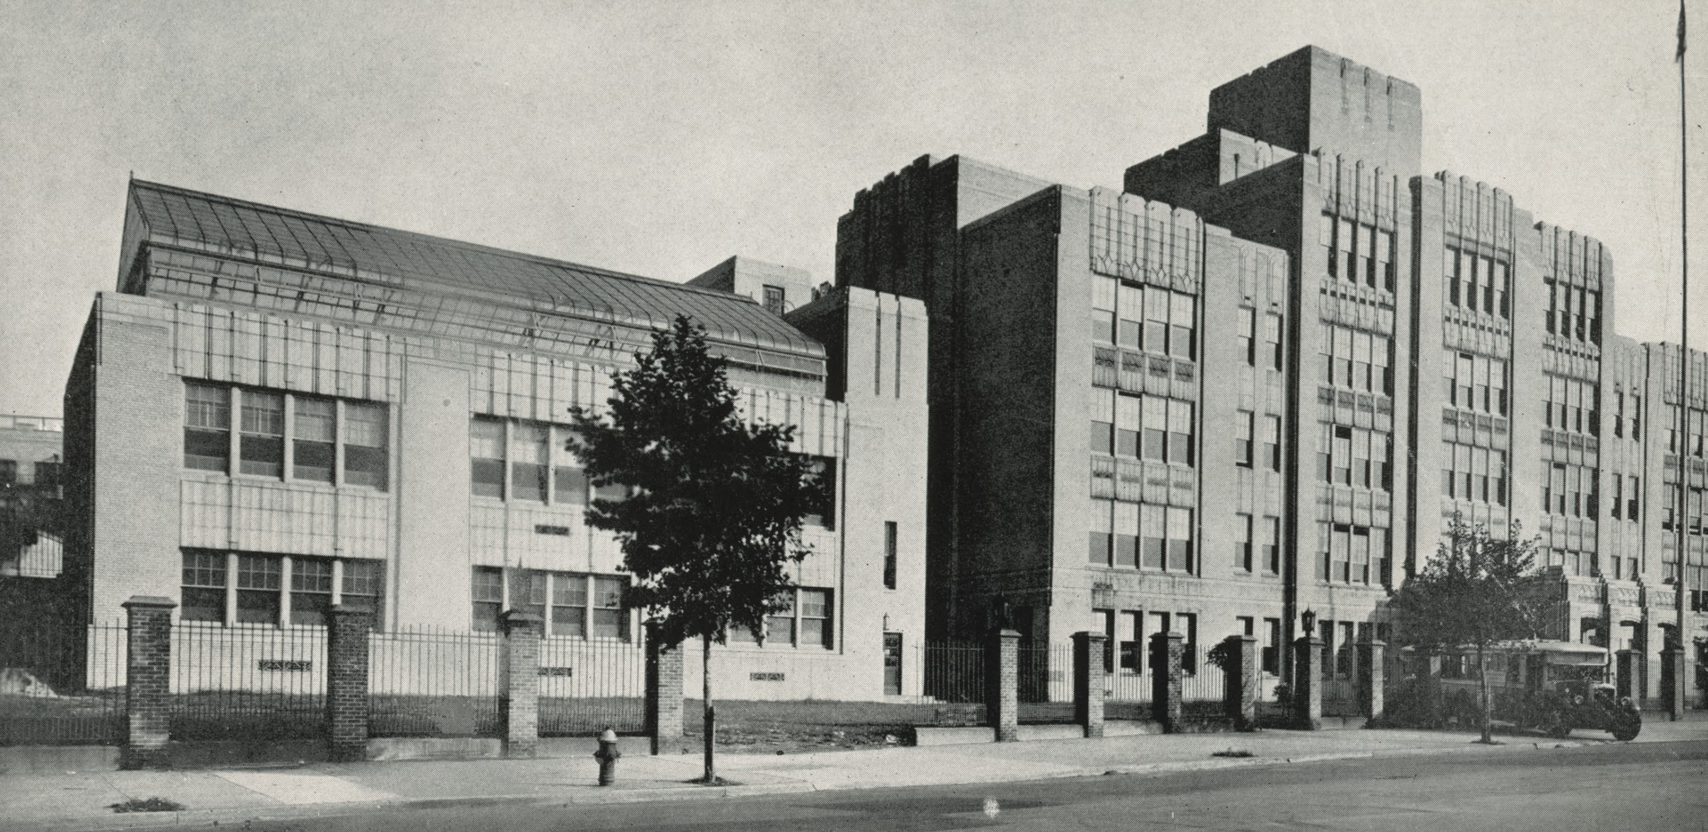
A CASE STUDY OF THE INTEGRATION OF ROBOTICS TO SUPPORT THE EDUCATIONAL AND THERAPEUTIC GOALS OF STUDENTS WITH LOW-INCIDENCE DISABILITIES
Stephanie Talalai
Chair: Dr. Laura Zieger
March 19, 2018
Notes:
Thank committee, humbling experience

Slide 2
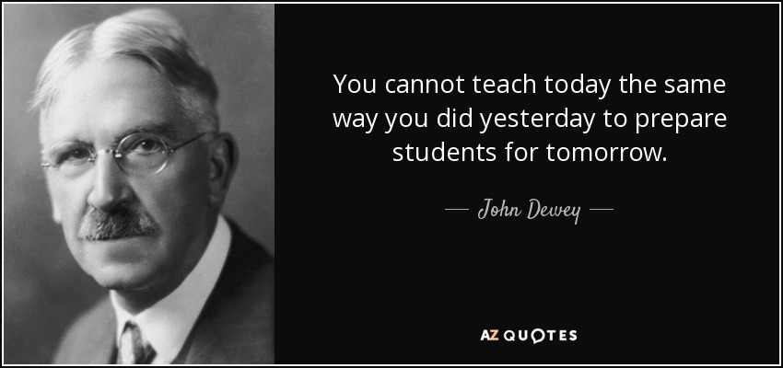
Notes:
I wanted to start with a quote from John Dewey:
You cannot teach today the same way you did yesterday to prepare students for tomorrow

Slide 3
The Problem
No Child Left Behind (Hodge & Welch, 2016; Hourigan, 2014)
Every Student Succeeds Act (Hodge & Welch, 2016)
STEM Education and Robotics for students with Low-Incidence Disabilities (Damiani & Ascione, 2017; Ko & Ladner, 2016; Lindsay & Hounsell, 2017) (Grynszpan, Weiss, Perez-Diaz, & Gal, 2014; Kaboski et al., 2015; Yuen, Mason, & Gomez, 2014)
Notes:
According to 2002’s No Child Left Behind Act, students with disabilities are required to have access to, and make yearly progress, in the same academic curriculum as their non-disabled peers (Hodge & Welch, 2016; Hourigan, 2014). Additionally
In 2015, Every Student Succeeds Act required teachers of students with disabilities to assess their students on the same standards as their typically developing peers (Hodge & Welch, 2016).
These mandates often leave teachers of students with disabilities, especially those with low-incidence disabilities, searching for innovative and engaging ways to present curricular material to their students
With the increasing use of STEM programs in schools, the use of technology, specifically robotics has become a key component in today's curriculum (Damiani & Ascione, 2017; Ko & Ladner, 2016; Lindsay & Hounsell, 2017).
And while there have been several studies conducted on the use of Humanoid Robots as a therapeutic intervention for students classified as autistic (Grynszpan, Weiss, Perez-Diaz, & Gal, 2014; Kaboski et al., 2015; Yuen, Mason, & Gomez, 2014). the specific problem is that the implementation and perceived impact of robotics for the education and therapeutic goals of students classified with low-incidence disabilities remain unknown.

Slide 4
Purpose of the Study
To evaluate teacher, therapeutic and administrative knowledge, implementation and perceptions of the use of robotics for students with low-incidence disabilities in an inclusive school setting
To gain an understanding of how robotics impact student educational and therapeutic goals.
Notes:
The purpose of this study is to
To evaluate teacher, therapeutic and administrative knowledge, implementation and perceptions of the use of robotics for students with low-incidence disabilities in an inclusive school setting
To gain an understanding of how robotics impact student educational and therapeutic goals.

Slide 5
Research Questions
What role does administration play in successful school-wide robotics implementation?
How do teacher's and therapist’s knowledge and implementation of robotics influence the attainment of educational and therapeutic IEP goals for students with low-incidence disabilities?
What patterns emerge in the experiences and perceptions of teachers, therapists, and administrators during the implementation of robotics as an educational and therapeutic tool for students with low-incidence disabilities?
What principles of UDL are represented by the implementation of robotics into curricular activities for students with low-incidence disabilities in their classrooms?
Notes:
The research questions that guided this study are:
What role does administration play in successful school-wide robotics implementation?
How do teacher's and therapist’s knowledge and implementation of robotics influence the attainment of educational and therapeutic IEP goals for students with low-incidence disabilities?
What patterns emerge in the experiences and perceptions of teachers, therapists, and administrators during the implementation of robotics as an educational and therapeutic tool for students with low-incidence disabilities?
What principles of UDL are represented by the implementation of robotics into curricular activities for students with low-incidence disabilities in their classrooms?

Slide 6
Theoretical Framework
Universal Design for Learning (UDL)
Universal Design for Learning (UDL) is based on three primary principles:
Multiple means of representation
Multiple means of action and expression
Multiple means of engagement
(Center for Applied Special Technology [CAST], 2011).
The Technology Acceptance Model (TAM), developed by Davis in 1985
Notes:
All students need assistance when learning, but it is vital that this assistance be diverse and meets the student’s strengths, needs, and interests (Grasmick, 2011).
Universal Design for Learning guided this study as a researched-based framework for curriculum development that provides powerful supports for learning while reducing the barriers often encountered by students with disabilities (Center for Applied Special Technology [CAST])
3 Primary principles
Representation: giving diverse learners options for acquiring information and knowledge
Action and Expression: providing learners options for demonstrating what they know
Engagement: tapping into learners’ interests, offering appropriate challenges, and increasing motivation
The Technology Acceptance Model is a second theoretical framework relevant to the use of robotics in the education of students with disabilities (Davis, 1985). According to Davis (1985), individuals are more likely to adopt or “accept” a technology if they perceive the technology to be both useful and easy to use and are less likely to use a technology if they lack the skills or technological confidence to engage with the interface or operate it. When applied to the use of robotics in the education of students with disabilities, the Technology Acceptance Model suggests that teachers are more likely to use robotics in their classrooms if they understand how robotics would benefit themselves and their students, and feel confident in the operation of the robotics (Davis, 1985). Furthermore, an individual’s perceived usefulness is highly relevant to their likelihood of adopting a specific technology, meaning ease of operation is generally not a sufficient motivator (Davis, 1985).

Slide 7
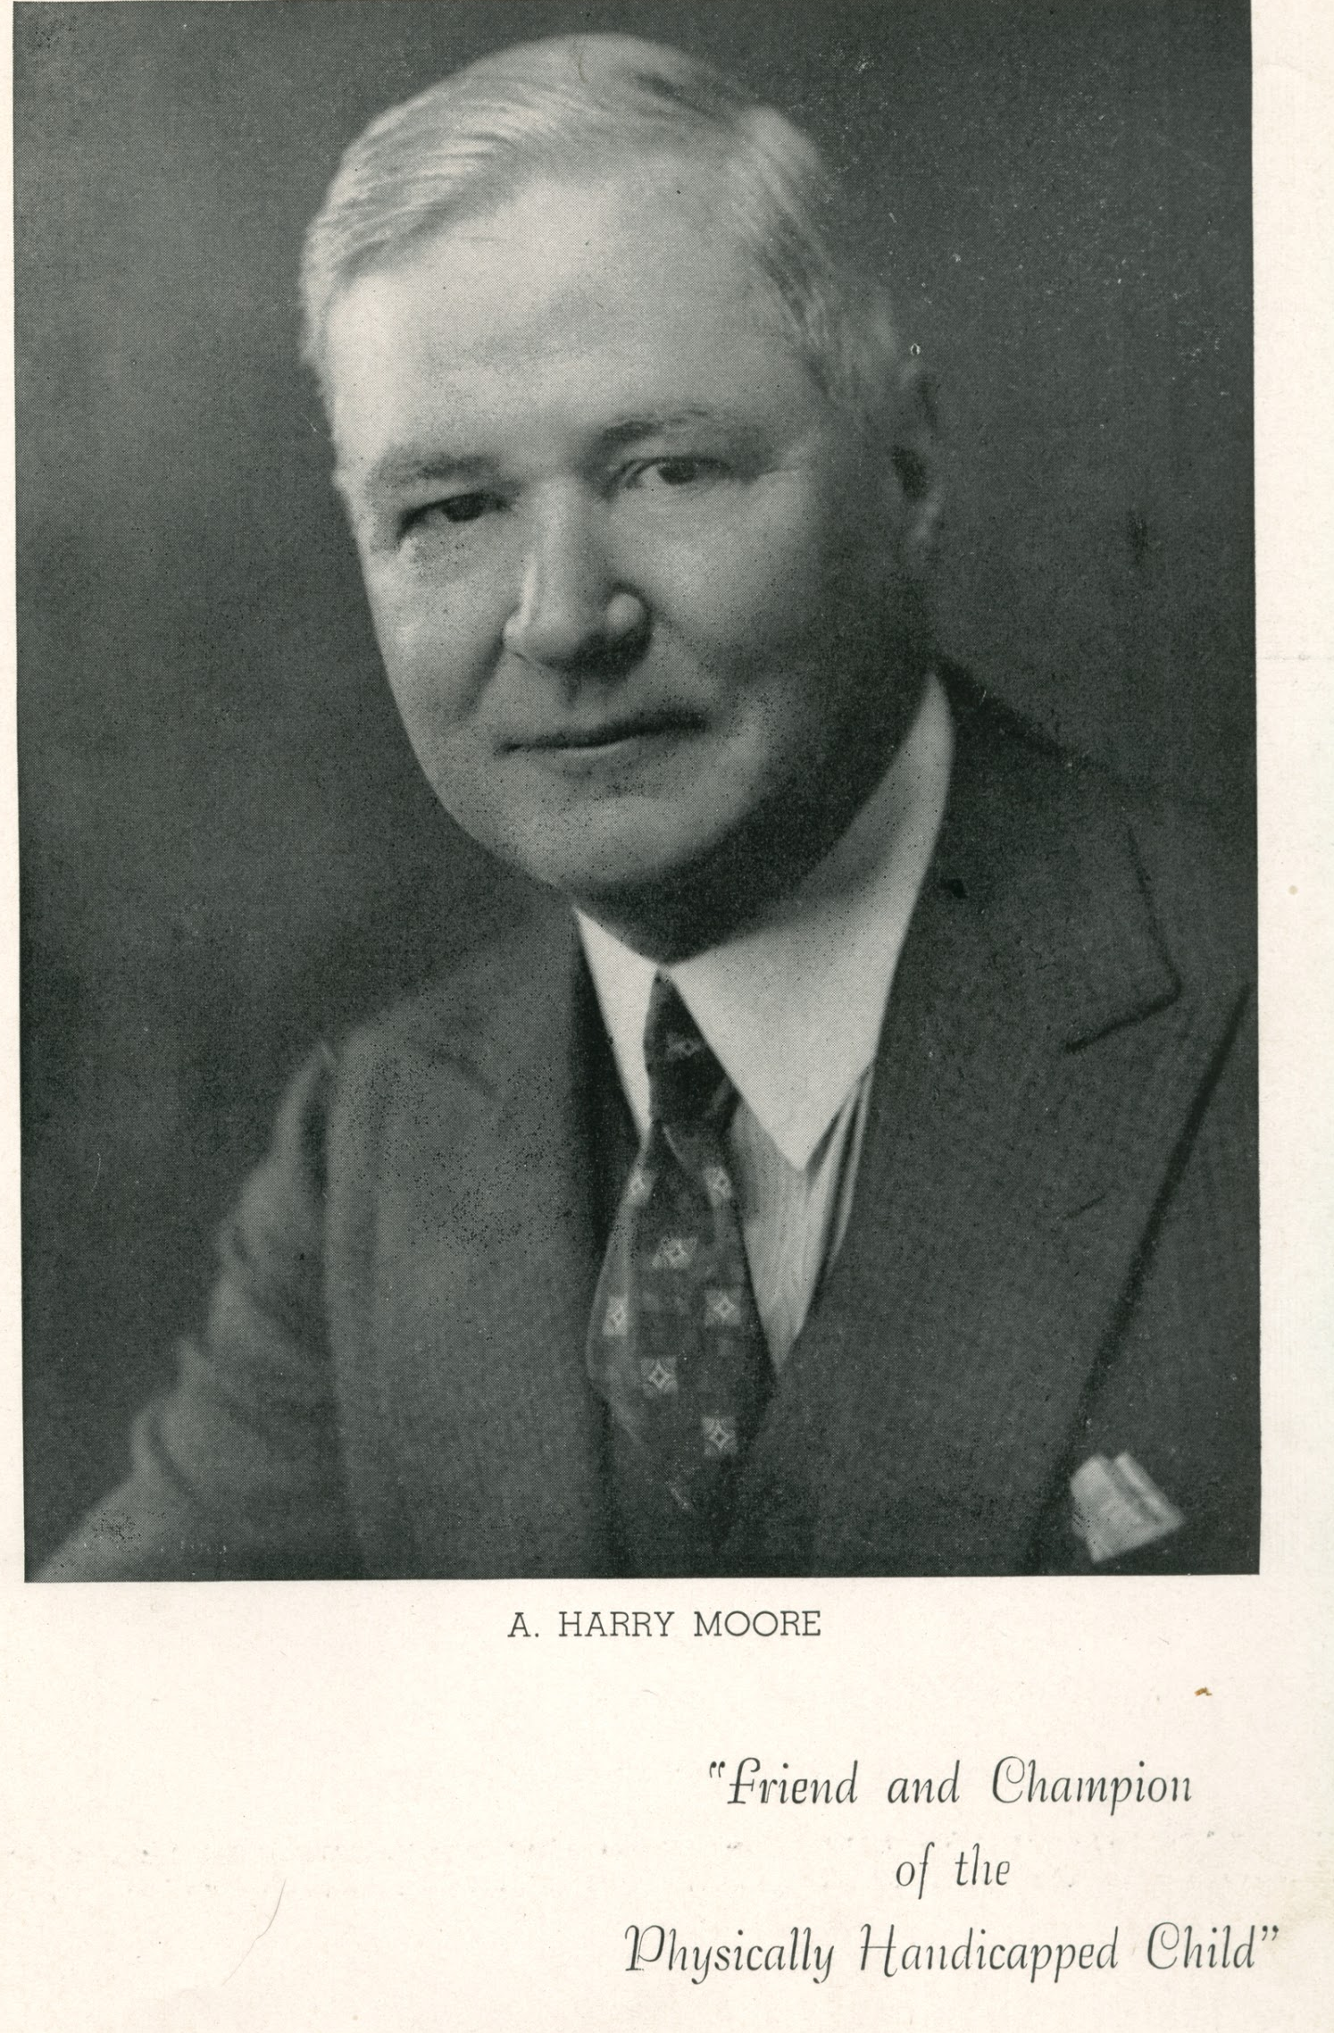
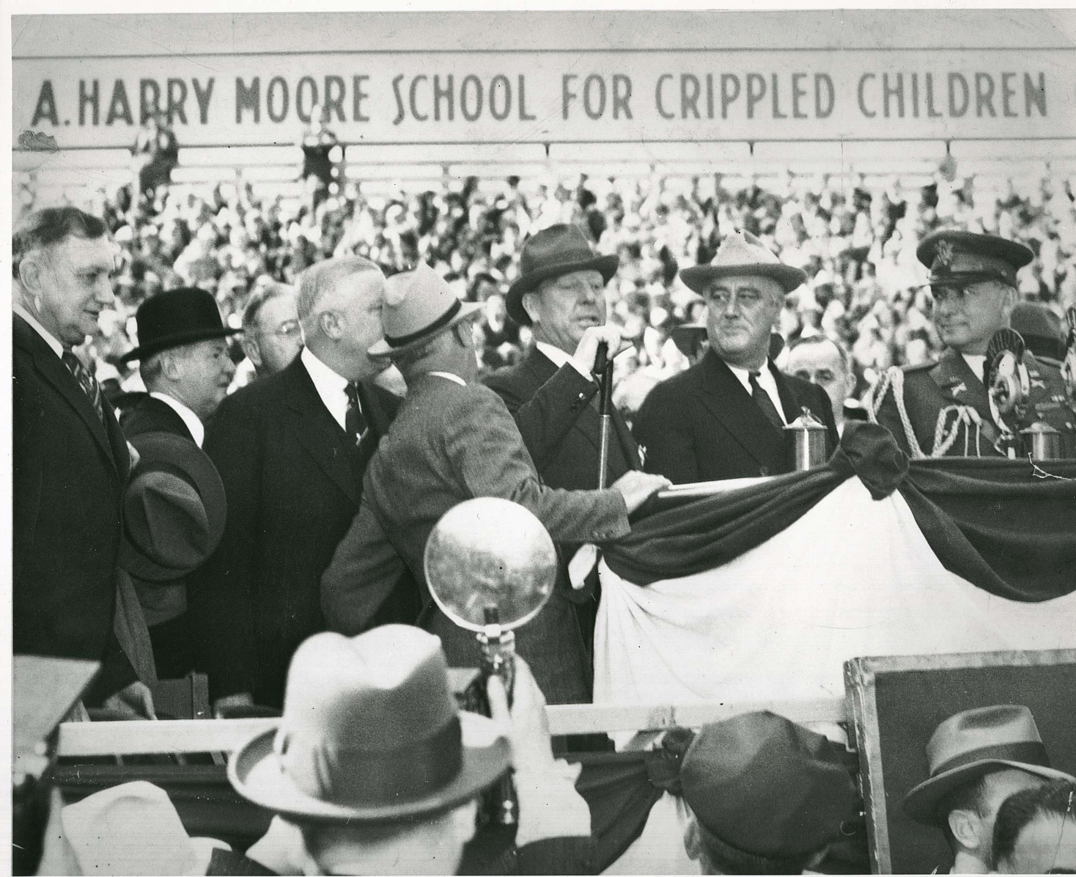
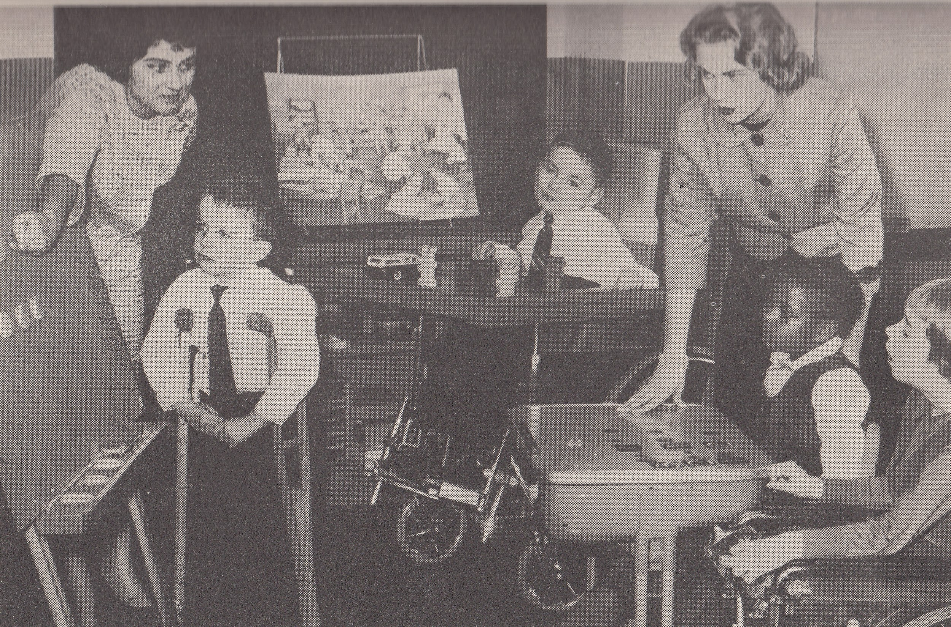
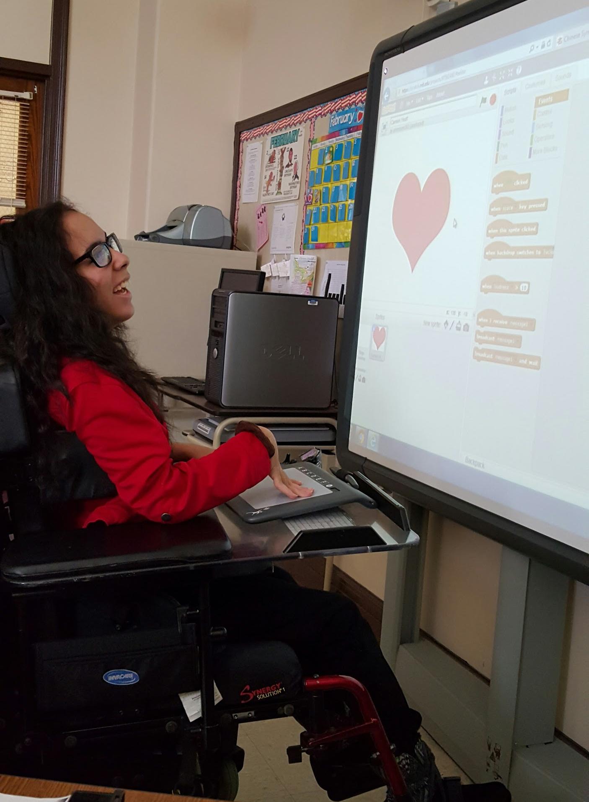
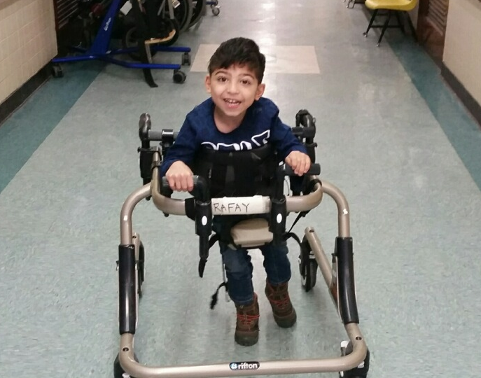
A. Harry Moore
School
Notes:
This study took place at the A. Harry Moore School. Opening in 1931 and named after NJ Governor Arthur Harry Moore, this school was one of the first in the nation to provide a public education to children with physical disabilities. Today A. Harry Moore is a department of New Jersey City University and is recognized for its innovative use of not only assistive technologies but also educational technologies such as robotics. The school offers a comprehensive educational and medically related program for approximately 100 students with low-incidence disabilities. These disabilities include visual and hearing impairments, developmental disabilities, severe and multiple disabilities and severe intellectual impairments. ??Students with low-incidence disabilities make up only 20% of students classified with a disability.??

Slide 8
Qualitative
Research Design
Exploratory Single Case Study
IRB Approval
University Approval
Participant Recruitment
Pre-observation Interviews
Robotics infused lesson observation
Post-observation Interviews
Data Analysis
6 Major Themes Emerged
Notes:
This qualitative research study employed an exploratory single case design
Erikson (2012) states that qualitative studies in education are particularly useful when detailed information is needed about a specific implementation and Yin (2013) states that case studies are used when the researcher is exploring the “How” and “Why” of a question.
After receiving IRB Approval I sought approval from both NJCU and the principal of A. Harry Moore
I then sent e-mails to the 23 teachers, 14 therapists and 3 Administrators at A. Harry Moore explaining my study and seeking participants
After my participants were selected, I conducted Semi Structured Pre-observation Interviews to obtain background information on how and why robotics will be integrated into the lesson, the targeted IEP goal, and the amount and type of professional development provided to the teacher or therapist.
I then observed a Robotics infused lesson where I took field notes and reflective notes about the lesson and the setting
Post-observation Interviews were then conducted to allow the teachers and therapists to elaborate on how lessons or therapy sessions were prepared and why certain instructional/therapeutic decisions were made. The post-observation interview also allowed teachers and therapists to expand upon their concerns, obstacles, and successes with robotics implementation and elaborate on the UDL principles
Data Analysis was conducted by transcribing all interviews and observational data and importing the data into NVivo 11 Software. From this analysis, 6 Major Themes Emerged

Slide 9
Population
A. Harry Moore School Participants
2 Administrators
6
Classroom Teachers
3
Therapists
Notes:
From my participant emails I identified 11 participants
2 Administrators
6 Classroom Teachers
Preschool, Primary, Middle School, High School, Science/Math Specialist, Recreation Specialist
3 Therapists
Speech, Physical, Occupational

Slide 10
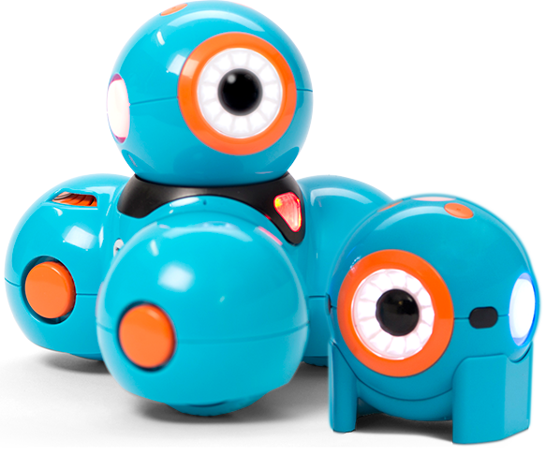
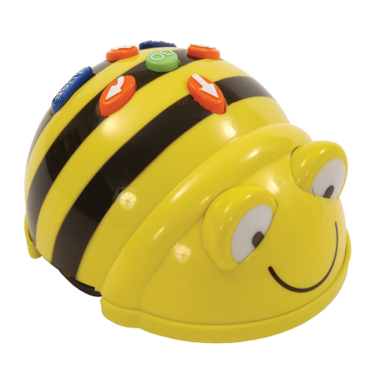
The Robotics
Dash
$150
Ozobot
$50
BeeBot
$80
Sphero
$130
Notes:
The teachers and therapists utilized 4 different types of low-cost robotics for their lessons and therapy sessions
Ozobot, BeeBot, Sphero and Dash
These robots are fairly affordable ranging from $50 t0 $150

Slide 11
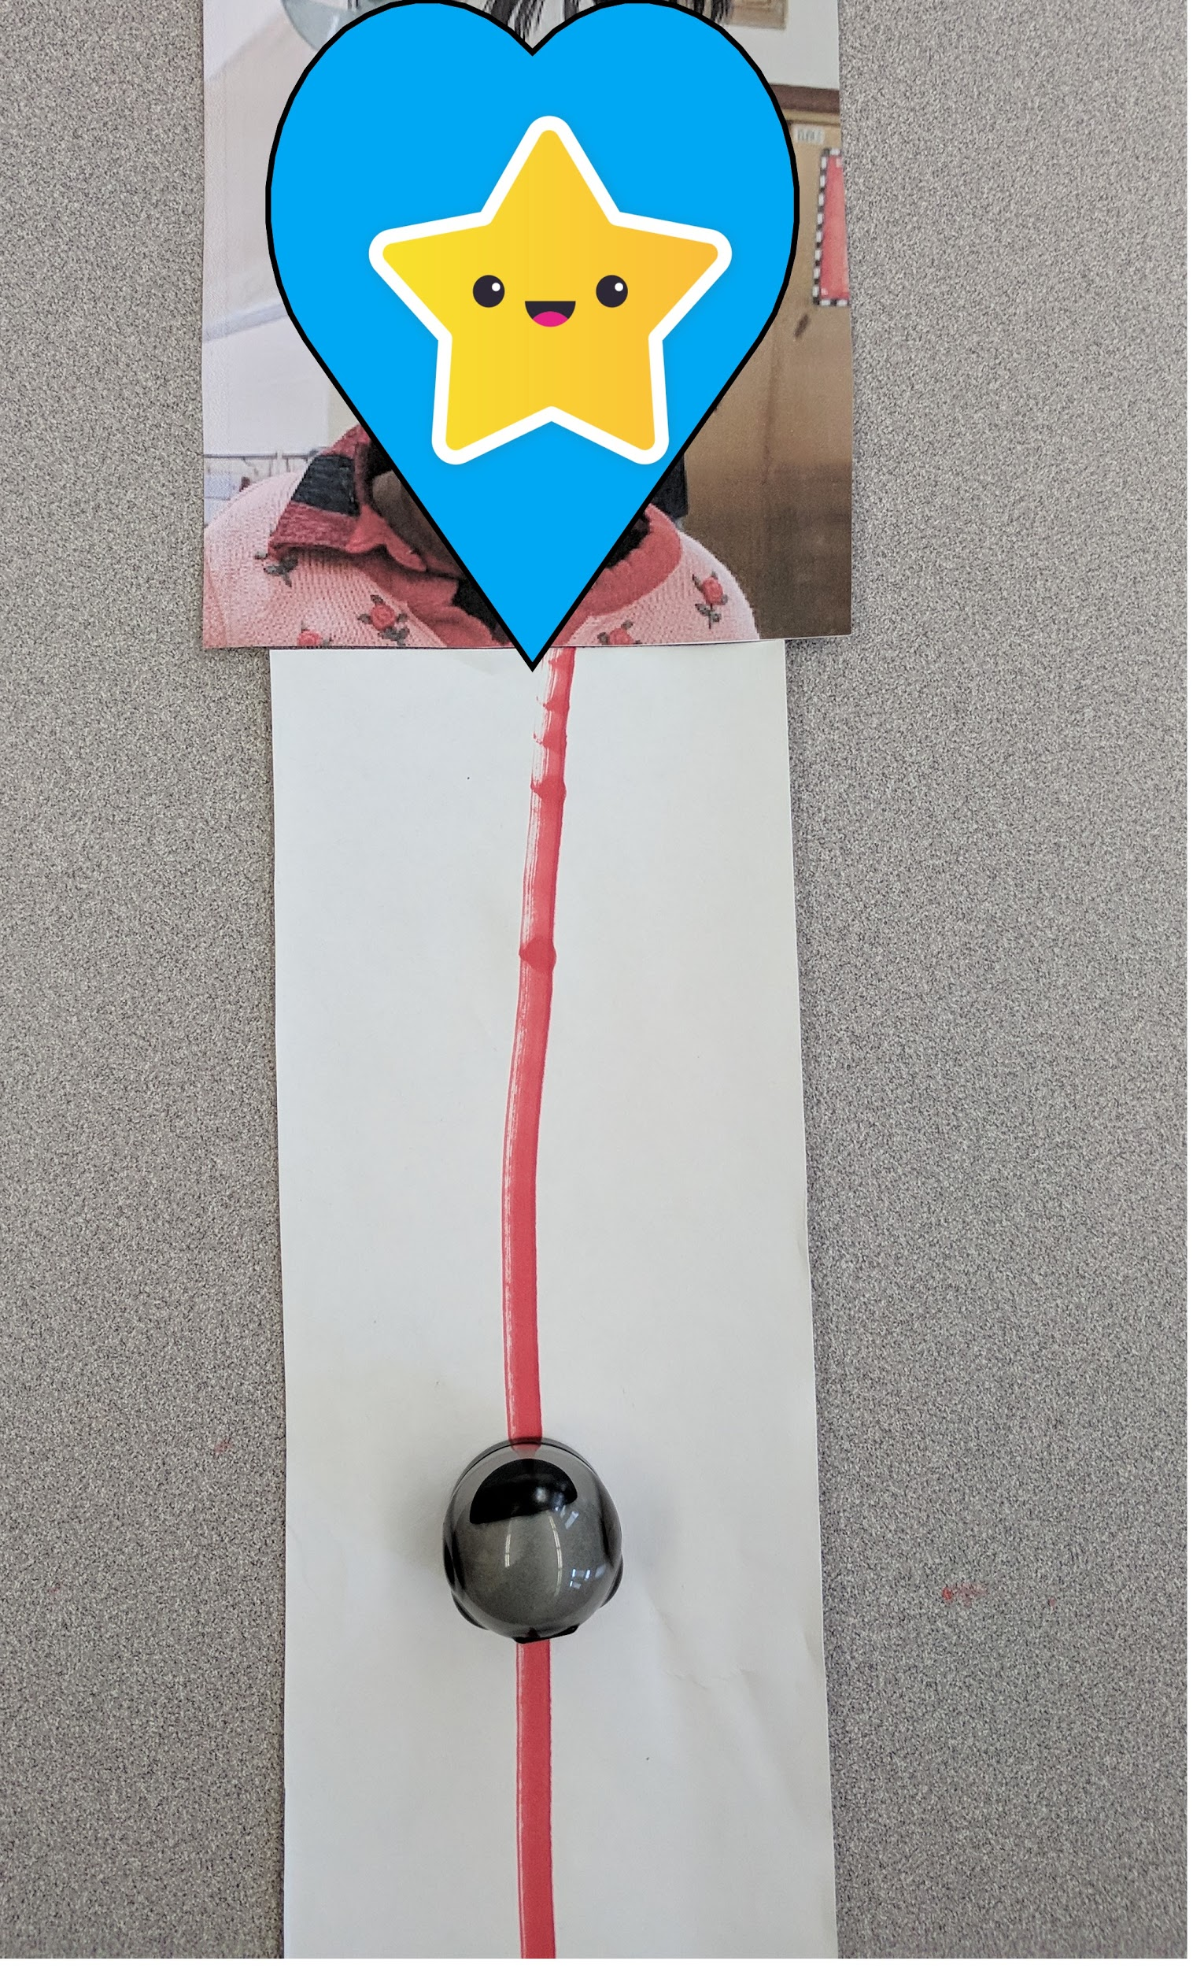
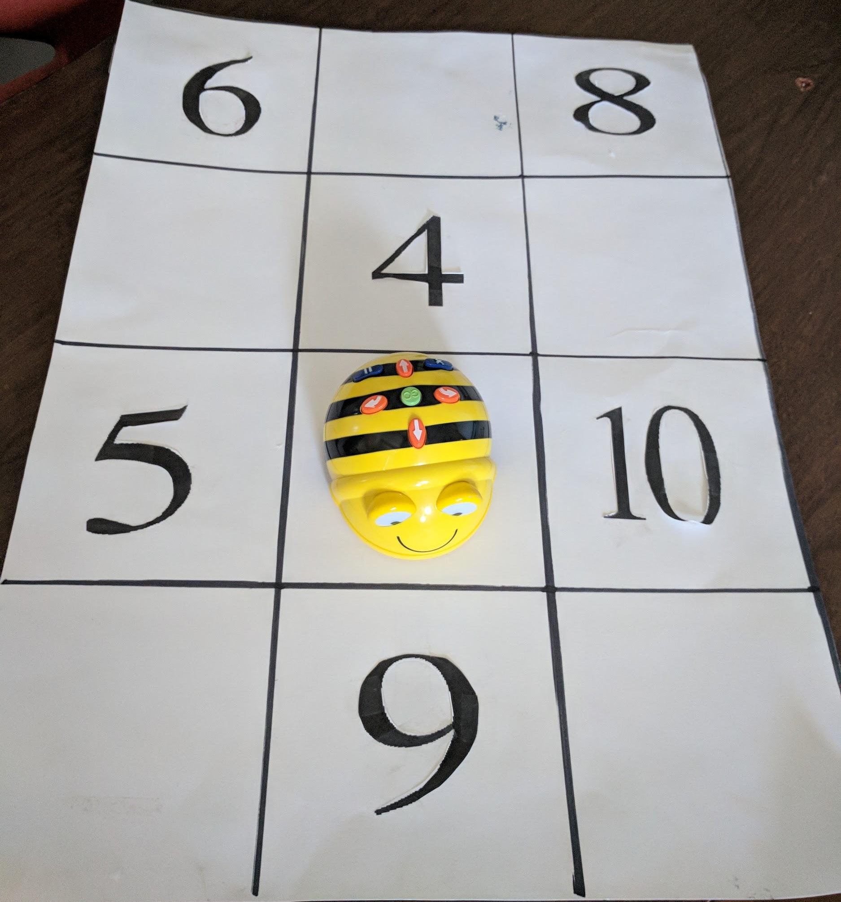
Preschool Teacher Emma
Primary Teacher Allison
Middle School Teacher Charlotte
Ozobot - All About Me
Preschool Teaching and Learning Standard 6.1.1
BeeBot - Math
Common Core Standards K.OA.1, 1.OA, 2.OA
Sphero - Passage of Mayflower
Common Core Standard 6.1.4.D.5
Notes:
Preschool Emma - 25 years experience, Ozobot for All About Me (teaching students to identify themselves, hand-eye coordination, fine motor skills), Students new to robotics, Challenge (not putting robot in mouth) she also felt that the demands of the schedules, students being pulled in and out for therapies and for specials throughout the day and having the time to train her staff were some of the biggest constraints for robotic implementation
Primary Allison - 22 years of experience, first became interested in robotics by watching her colleagues use them. She felt that Robotics are great for Differentiation. In her math lesson she was able to use the same robot and board for all the students but ask them different questions. She thought robotics were a good way motivate the students, keep them engaged and give them options. She stated “its good for me too because I am continuously teaching the same concepts and I would get bored so I know they get bored with the same old lesson”. I don’t have to pump them up or try to convince them that it is going to be fun, I just show them the BeeBot and they know they’re going to have fun”
Middle School Charlotte - 24 years of experience and uses robotics as a way of engaging student in content that may be a higher level academically than their current functioning level and they allow her students to demonstrate what they are learning. In her lesson she used a sphero robot to demonstrate the passage that the pilgrims took from England to the new world. She believed that the use of robotics helped her students to recount the passage. But stressed the importance of making sure that the technology is working properly before the lesson begins.

Slide 12
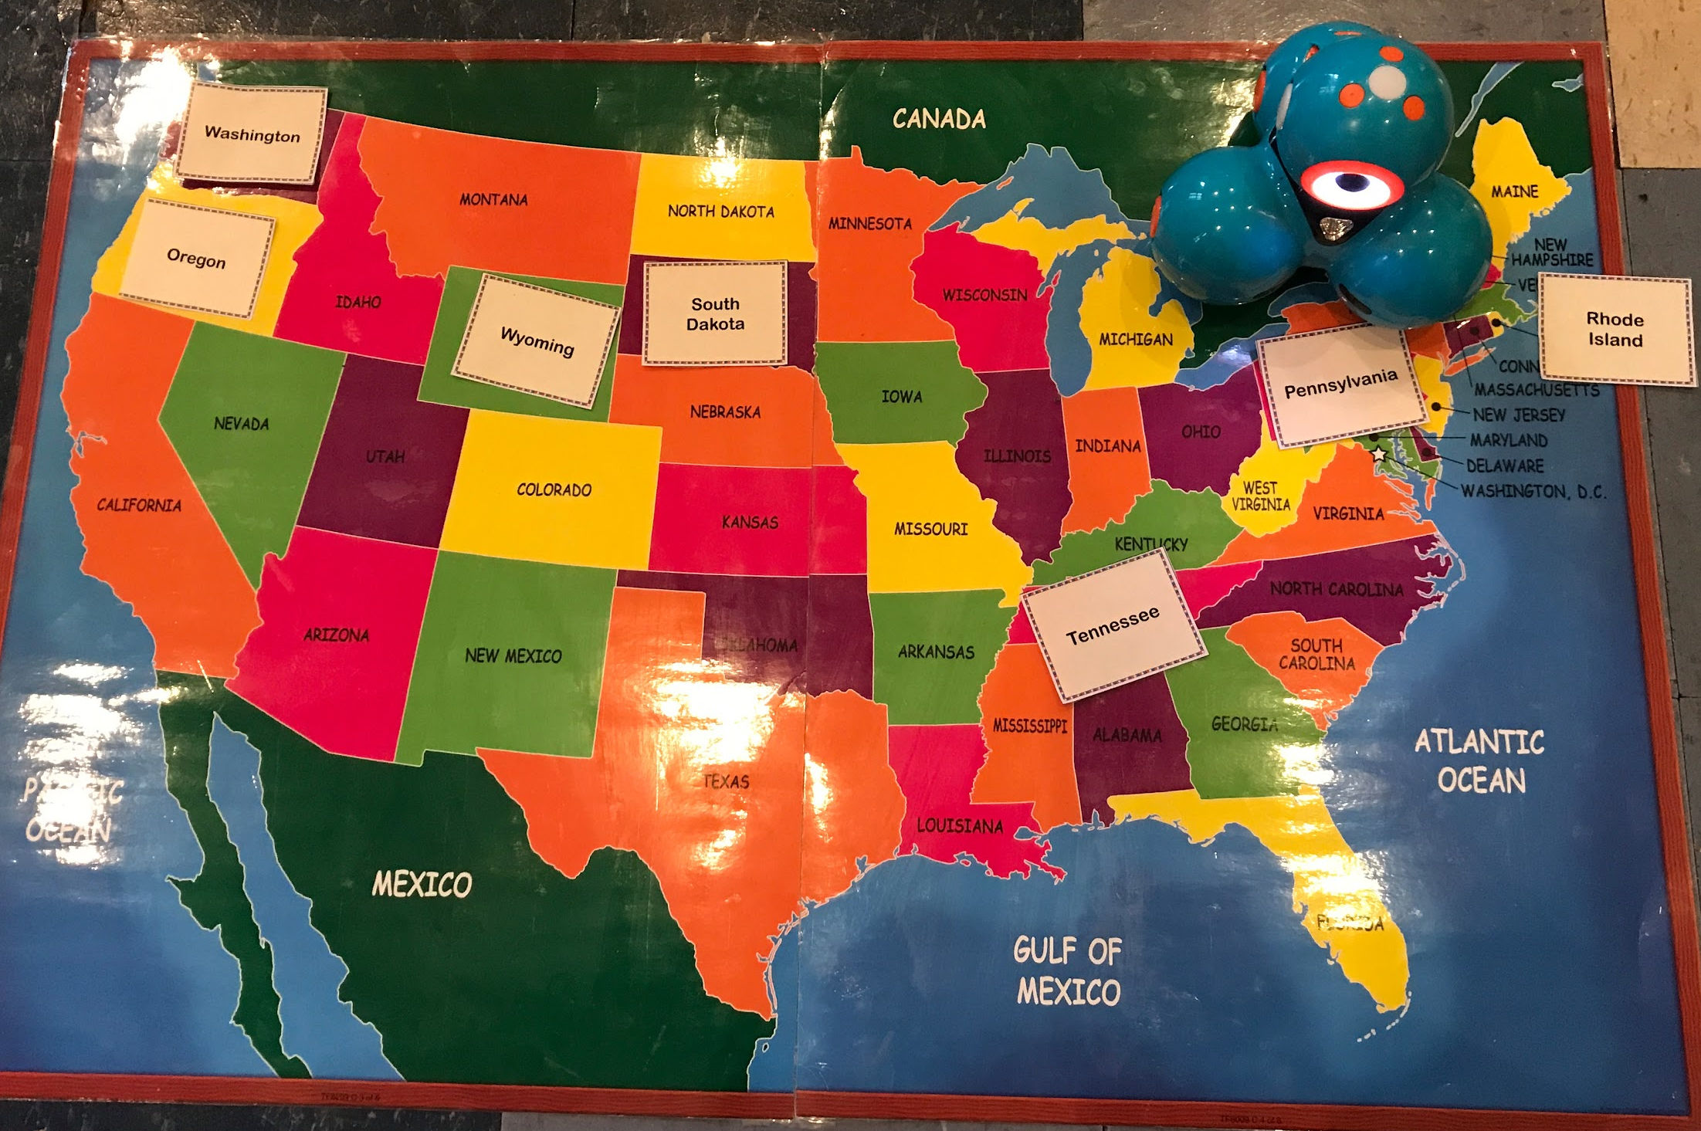
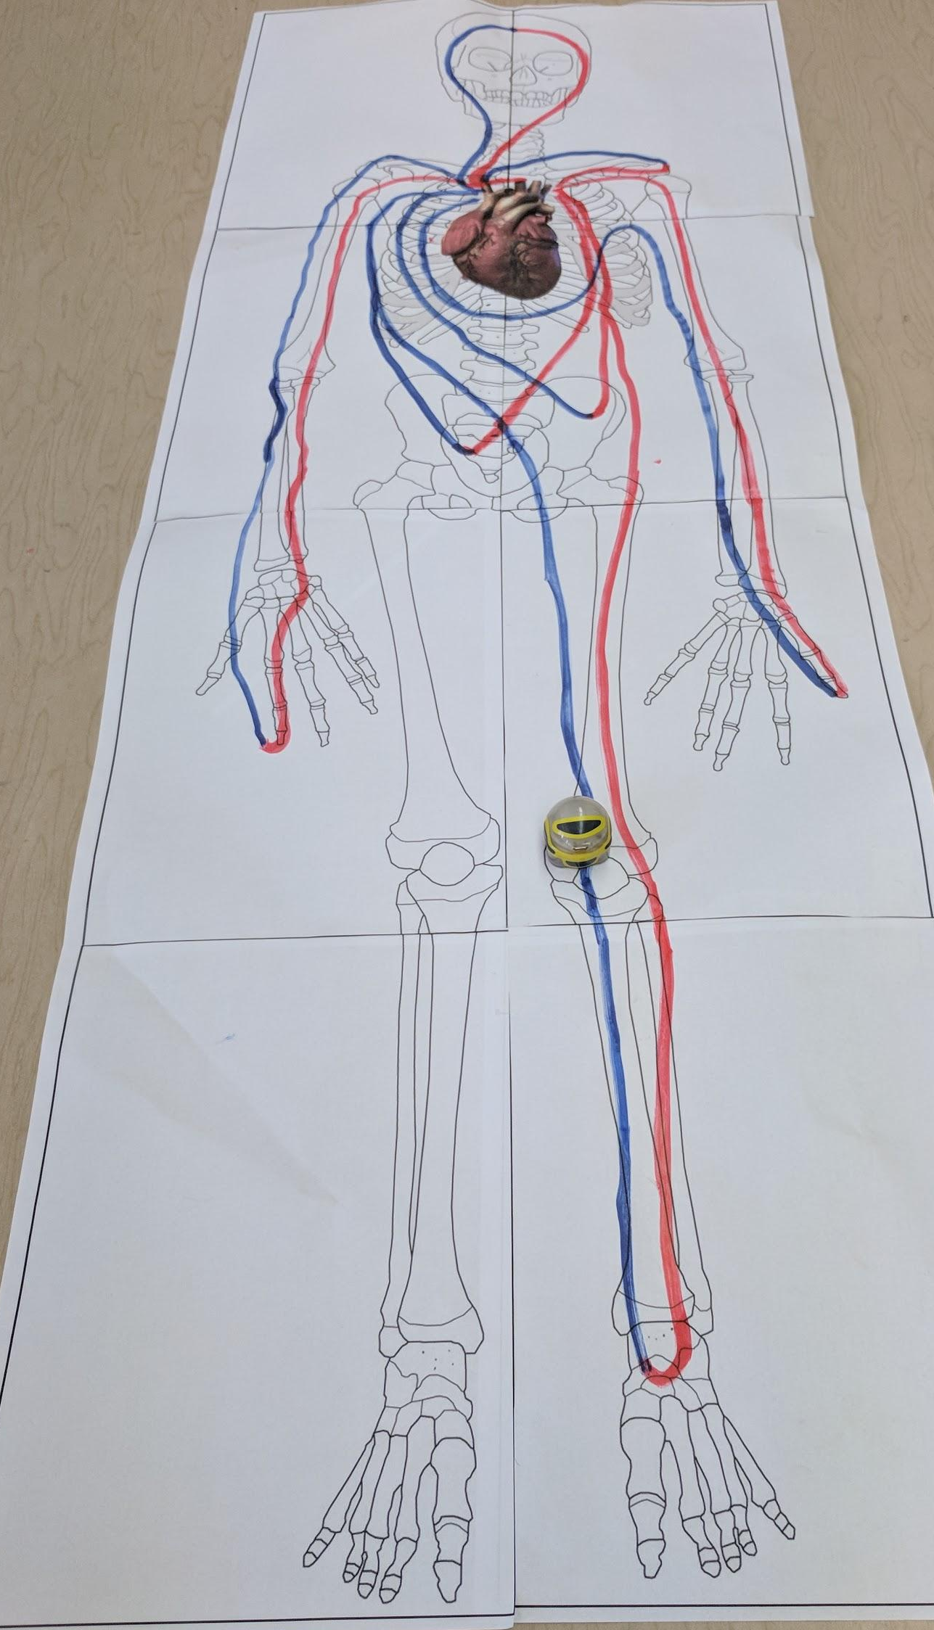
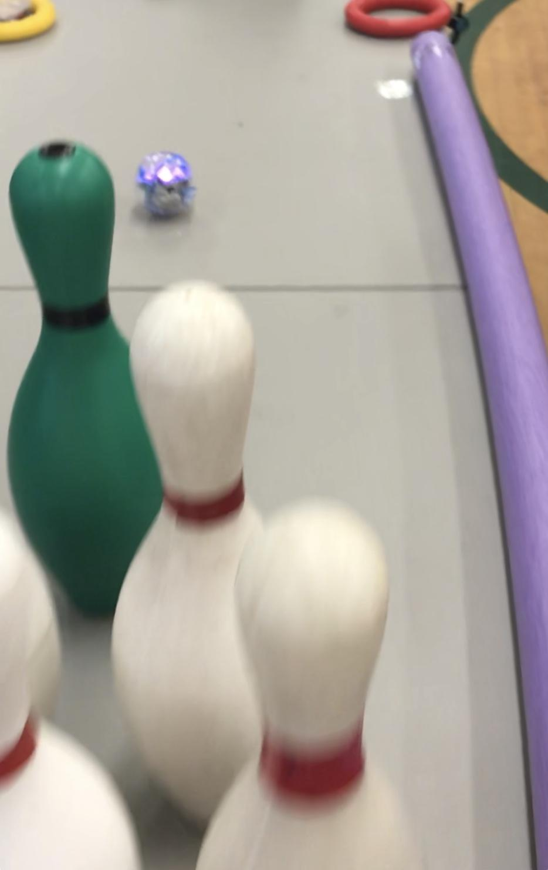
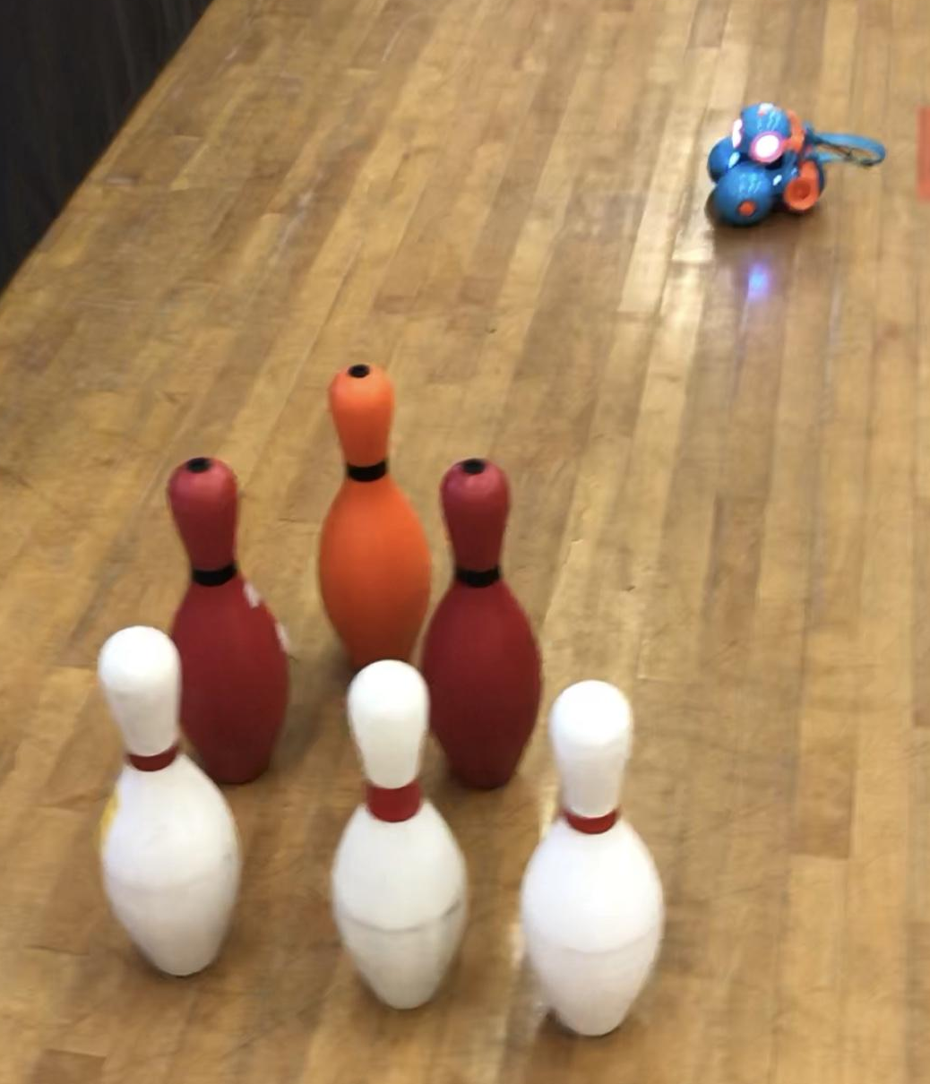
High School Teacher Sarah
Teacher Natalie
Teacher Denise
Dash - Geography
Common Core Standard 6.1.4.B.6
Ozobot - Circulatory System
Next Generation Science Standard HS-LS1-2
Sphero & Dash - Bowling
Common Core Standard
Notes:
High School Sarah: New teacher with 4 years experience, she used Dash to help her students identify states on a large map she put on the floor in the auditorium, she stated that she likes using robotics because they are a great attention getter, they help to keep her students engaged in the lesson for longer periods of time and they add a playful element to learning. She also felt that even her students whose disabilities prevent them from physically participating in your typical paper and pencil activities have more of a level playing field when participating in an activity where they can control a robot to answer a question. She also said that when using robotics you need to plan ahead because they are not always conducive to planning “on the fly”
Teacher Natalie (Science/math enrichment) 30 years experience, uses robotics as a way to have her students examine and explore topics that their non-disabled peers are also exploring, her lesson involved using an ozobot to explore and explain the movement of oxygenated blood to and from the heart. She stated that robotics fosters collaboration not only among the students but also among the staff. She said “the more you use robotics and the more you integrate robotics into your lessons, the easier it is and the more seamless it becomes.
Teacher Denise (Recreational Specialist) with 29 years of experience used both Dash and Sphero in a bowling activity. She had three stations set up in the gym. The first one was a regular bowling station with a ramp and bowling ball, in the second one the bowling pins were placed on a table and the student used Sphero to knock them down and the third one resembled the fist station with with pins on the floor except that instead of a bowling ball the students used Dash to knock down the pins. She stated that robotics are very helpful because they give the students a more even playing field. With the robotics, all students can bowl despite their physical limitations. She was also surprised that one of the students bowled better using the robot than without. She said “this is how my class works, if you’re not successful one way, then we will find a way for you to be successful and robotics works great for that”.

Slide 13
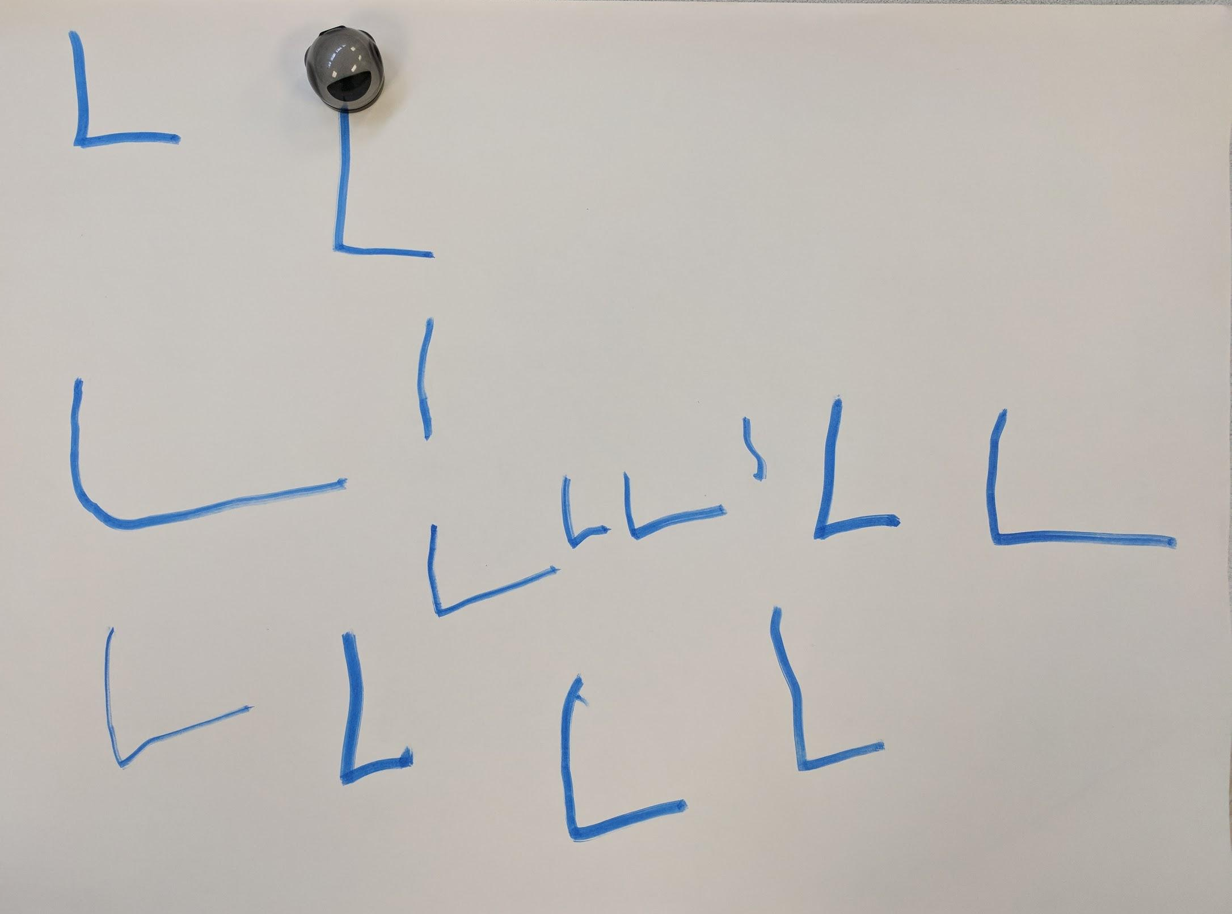
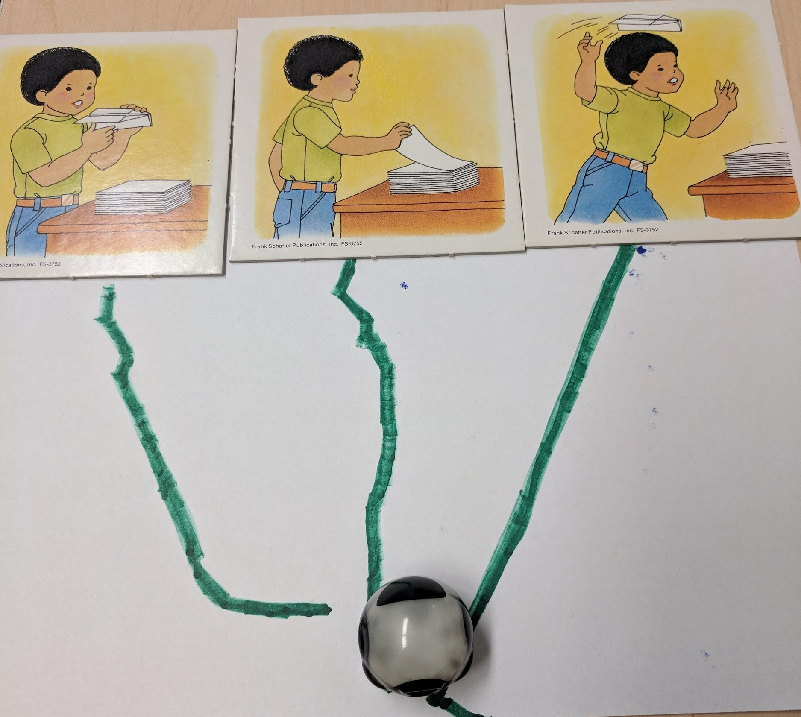
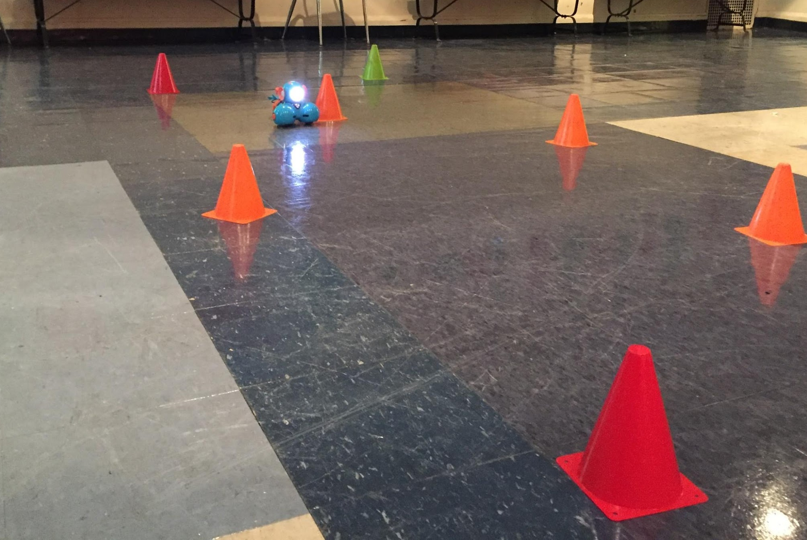
Occupational Therapist Andrea
Speech Therapist Olivia
Physical Therapist Elizabeth
Ozobot - Handwriting
Common Core Standard 2.5
Ozobot - Sequencing
Common Core Standard 3.3
Dash - Power Wheelchair Training
Common Core Standard
Notes:
The final three participants were therapists in the building
Occupational Therapist Andrea has been working at AHM for 26 years. She said that she likes bringing her students to the computer lab to use the robotics as an alternative activity to what would normally be considered pull out therapy in the therapy room. She sees robotics as another thing in her toolbox that could get kids excited about their therapy and kind of trick them into doing a lot more work. For her therapy session, She incorporated the ozobot into a handwriting program called Handwriting without tears. This is a developmental handwriting program that uses multimodal tools, such as chalk or Play-Doh, to try to teach letter formation. What she liked about using the robot was that the student stayed engaged in the activity for the whole session where normally he would just write the letter once and then ask for a different activity. She also said “I think their goals would be achieved a lot faster with the robot because I won’t have to struggle with them doing the repetition part of learning a skill”. She also expressed the need to have multiple robotics in the school so that more teachers and therapists could use them at the same time.
Speech Therapist Olivia has been working at AHM for 9 years. She was fairly new to robotics implementation stating that she more regularly used iPads during her therapy sessions. For her session, she used an ozobot to help her students sequence pictures cards and describe the scene on the cards. She felt that the use of robotics helped to keep the student engaged in the activity for a longer period of time but that having the student draw the lines limited the number of sequencing activity they were able to complete during her 30 minute session. She also felt that because she was fairly new to robotics implementation, that it took her longer to plan this lesson but that after she became more comfortable, it would be easier.
The final participant in the study was Physical Therapist Elizabeth. She has been a physical therapist for 11 years and working at AHM for the past 4 years. She said that her one therapeutic objective for implementing robotics was getting kids who have limited physical abilities to really participate and be motivated about movement. For her therapy session, she set up an obstacle course in the school auditorium for Power Wheelchair training. Her goal was to have the student follow Dash through a series of cones without hitting any of them. When doing this activity previously, she would have the student follow her through the cones but the student disliked the activity and never looked down to pay attention to the cones. Elizabeth was amazed that the student not only was motivated to follow the robot but that she actually paid attention to where the cones were placed and avoided them. She stated that in the future she would calculate distance traveled and the percentage of cones that were hit or missed so that she would be able to quantify her results.

Slide 14
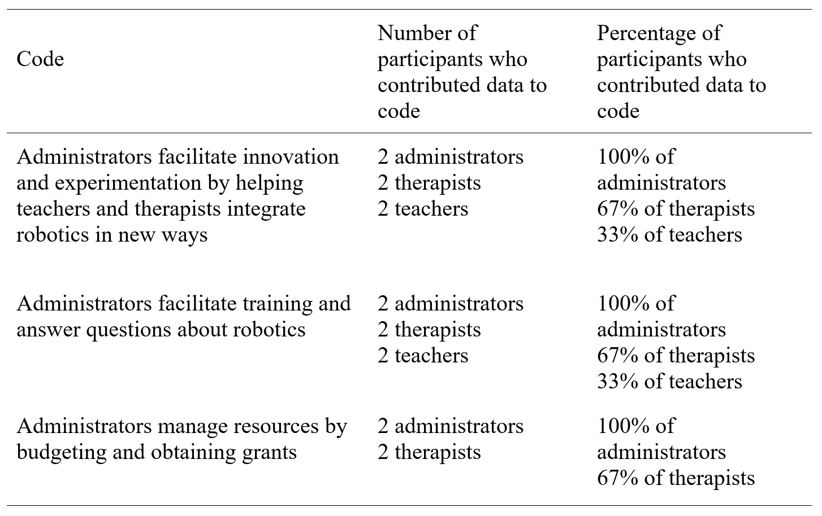
Major Theme One
Administrators’ role involved managing resources to make robotics available, supporting teachers’ and therapists’ use of robotics by providing training and answering questions, and facilitating innovation in the use of robotics in education.
Notes:
Major theme 1 Addressed research question 1 and the Administrators’ role in robotics implementation within the school
Both administrators conveyed the importance of making robotics available to teachers, therapists and students and giving them the freedom to not only experiment with the robots but to share their experiences with other teachers and therapists to promote more buy-in from the staff.
Administrators, Teachers and Therapists all felt that training was an important factor is successful robotics implementation and that after initial training by the technology coordinator, most of the training was turn-key
Both Administrators and Therapists felt that an administrators role in successful school wide robotics implementation involved managing resources by budgeting and obtaining grants to purchase enough robotics for the school to use

Slide 15
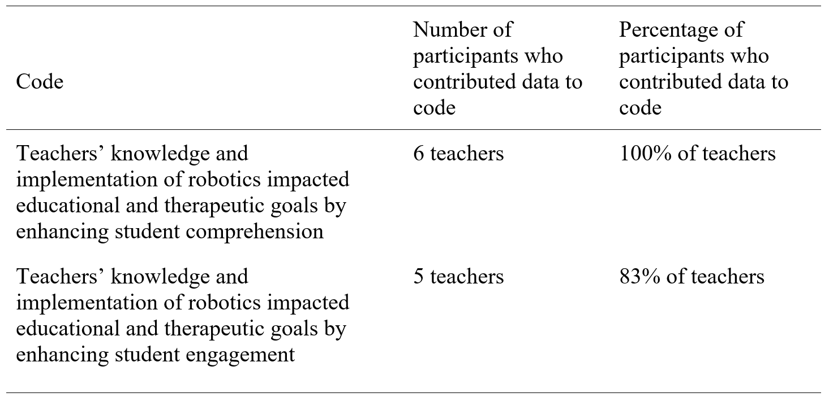
Major Theme Two
Teachers’ knowledge and implementation of robotics impacted educational and therapeutic goals by enhancing student engagement and comprehension.
Notes:
Major theme 2 addressed research question 2 and how Teachers’ knowledge and implementation of robotics impacted educational and therapeutic goals
The classroom teachers in this study indicated that the use of robotics increased student comprehension of the curriculum and enhanced student engagement.

Slide 16
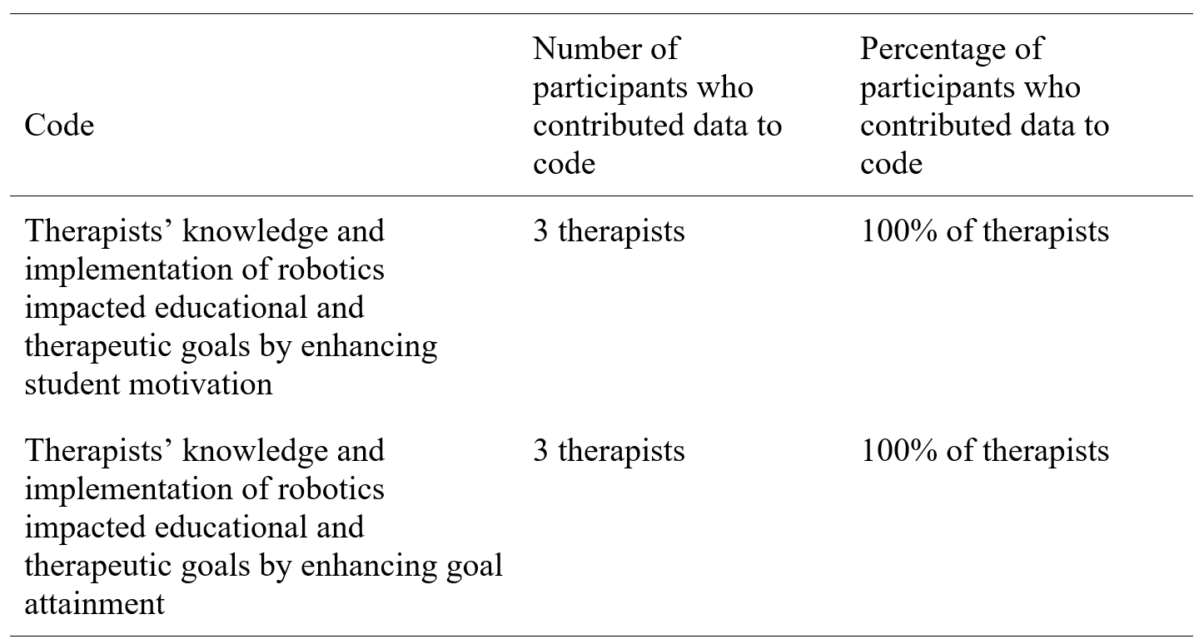
Major Theme Three
Therapists’ knowledge and implementation of robotics impacted educational and therapeutic goals by enhancing student motivation and goal attainment.
Notes:
Major theme 3 also addressed research question 2 Therapists’ knowledge and implementation of robotics impacted educational and therapeutic goals
All three therapists expressed that the use of robotics in their therapy sessions motivated the students to not only try harder but kept them engaged in the activity for a longer period of time which helped the student to attain their therapeutic goal at a quicker rate.

Slide 17
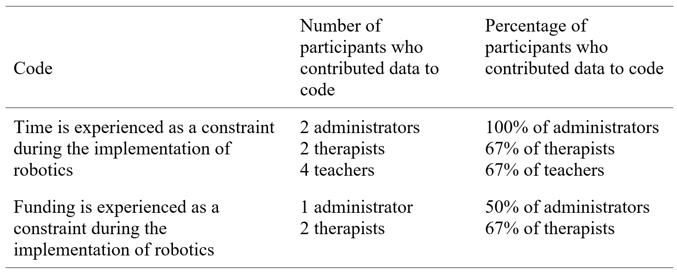
Major Theme Four
Teachers, therapists, and administrators experienced time and funding as constraints during the implementation of robotics.
Notes:
Major theme 4 addressed research question 3 and the constraints of time and funding experienced by the participants during the implementation of robotics
Administrators felt that they needed more time to implement the professional development needed for robotics implementation as well as providing the necessary amount of funding.
Teachers and therapist felt that implementing robotics into their lessons and therapy sessions involved needed more time for planning and set-up of the lessons.
Teachers also felt that more time was needed for the actual lesson when robots were being used.

Slide 18
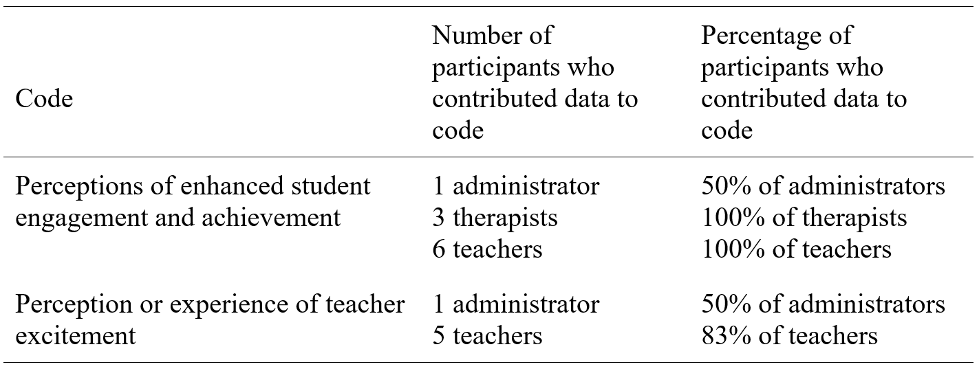
Major Theme Five
Administrators, therapists, and teachers perceived enhanced student achievement and engagement, and teachers experienced excitement, during the implementation of robotics.
Notes:
Major theme 5 also addressed research question 3 and the perceived enhancement of student achievement and engagement by the participants, and the excitement experienced by teachers
The participants indicated that Using robotics helps students with low incidence disabilities showcase what they know, keeps them engaged in the lesson for longer periods of time, and keeps the teachers excited and motivated about teaching.

Slide 19
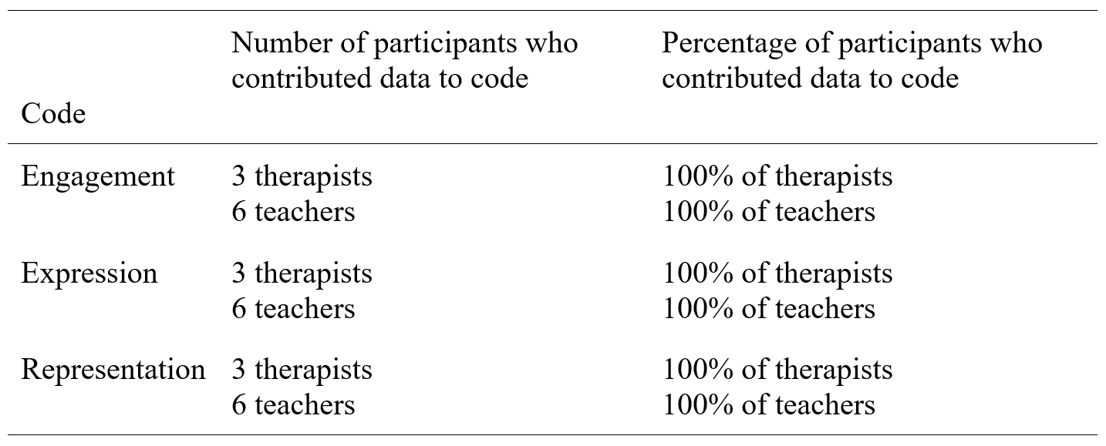
Major Theme Six
The UDL principles of engagement, representation, and expression were represented by the implementation of robotics.
Notes:
Major theme 6 addressed research question 6 and The UDL principles that were represented by the implementation of robotics
The principle of engagement was represented by the use of the robot as a way to keep the learners interested in the lesson, offer the learners appropriate challenges, and increase learner motivation
Teacher regularly use robotics to keep their students engaged in the lesson and motivated to learn
Robotics allow students to express themselves and provides the learners with the options for demonstrating what they know.
the UDL principle of representation was implemented through robotics when the robot was used as an alternative way to represent the curriculum

Slide 20
Conclusions
Robotics use increases motivation, goal attainment, enjoyment, engagement and comprehension
Administrators have an important role
Time and planning
Training
Supports UDL Principles
Notes:
The conclusions of this are:
That the teachers, therapists, and administrators all perceived the use of robotics by students with low-incidence disabilities as a way to increase motivation, engagement, goal attainment, comprehension and enjoyment.
That this study provided insight and evidence for the important role of administrators in the implementation and facilitation of robotics for children with low-incidence disabilities, that administrators are needed help manage the resources that make it possible to obtain robotic technologies and facilitate the training that is needed for successful implementation.
Successful robotics implementation requires time and planning on the part of the teachers and therapists
Supported by the Technology Acceptance Model, not only is a teacher more likely to incorporate robotic technology if she understands how to use it but is more likely to engage her students with that technology as well. So training is crucial.
The three primary UDL principles of providing multiple means of engagement, expression, and representation were all common themes within the data collected through interviews with the participants.
This study found educators need adequate training, knowledge, and resources in order to obtain, implement, and facilitate the use of robotics. Furthermore, this study found that properly implemented, educators believe robotics may greatly aid in the addressing the unique challenges faced by students with low-incidence disabilities and the teachers and therapists who work with them.

Slide 21
Recommendations
More research investigating the benefits robotics have on low-incidence disabilities
Increasing sample size
Expand research to look at specific needs of specific disabilities
Explore the impact of humanoid robots on the educational experience of students with low-incidence disabilities
Expanding the study to multiple school for students with low-incidence disabilities
Designing a quantitative study to measure how much improvement occurs after implementing robotics in aiding students with disabilities.
Notes:
My recommendations for future research includes more research investigating the benefits robotics have on low-incidence disabilities because there is a deficit of studies on the impact, benefit, and perceptions of robotics on students with low-incidence disabilities.
I would also recommend
increasing sample size
Expanding the research to look at the specific needs of specific disabilities
exploring the impact of humanoid robots on the educational experience of students with low-incidence disabilities
Expanding the study to multiple schools for students with low-incidence disabilities
And designing a quantitative study to measure how much improvement occurs after implementing robotics in aiding students with disabilities.

Slide 22
References
CAST (2011). Universal Design for Learning Guidelines version 2.0. Wakefield, MA: Author. www.cast.org
Damiani, P., & Ascione, A. (2017). Body, movement and educational robotics for students with Special Educational Needs. Italian Journal of Educational Research, 10(18), 43-58.
Davis, F. D. (1985). A technology acceptance model for empirically testing new end-user information systems: Theory and results (Doctoral dissertation, Massachusetts Institute of Technology).
Erickson, F. (2012). Qualitative research methods for science education. In B.J. Fraser, K. G. Tobin, & C. J. McRobie (Eds). Second international handbook of science education (pp. 1451–1469). Dordrech, The Netherlands: Springer Netherlands.
Grynszpan, O., Weiss, P. L., Perez-Diaz, F., & Gal, E. (2014). Innovative technology-based interventions for autism spectrum disorders: a meta-analysis. Autism, 18(4), 346-361.
Hodge, M., & Welch, J. (2016). An implementation perspective: Relevant lessons from no child left behind (NCLB) for the implementation of every student succeeds act (ESSA). Journal of Ethical Educational Leadership, 3(9), 1-17.
Hourigan, R. M. (2014). Intersections between school reform, the arts, and special education: the children left behind. Arts Education Policy Review, 115(2), 35-38.
Kaboski, J. R., Diehl, J. J., Beriont, J., Crowell, C. R., Villano, M., Wier, K., & Tang, K. (2015). Brief report: A pilot summer robotics camp to reduce social anxiety and improve social/vocational skills in adolescents with ASD. Journal of autism and developmental disorders, 45(12), 3862-3869.

Slide 23
References
Ko, A. J., & Ladner, R. E. (2016). Access Computing Promotes Teaching Accessibility. ACM Inroads, 7(4), 65-68.
Lindsay, S., & Hounsell, K. G. (2017). Adapting a robotics program to enhance participation and interest in STEM among children with disabilities: a pilot study. Disability and Rehabilitation: Assistive Technology, 12(7), 694-704.
Yin, R. K. (2013). Case study research: Design and methods: Thousand Oaks, CA: Sage.
Yuen, T. T., Mason, L. L., & Gomez, A. (2014). Collaborative robotics projects for adolescents with autism spectrum disorders. Journal of Special Education Technology, 29(1), 51-62.

